Slide 1
LECTURE 08 Recursion
TMA1201 Discrete Structures & Probability, Faculty of Computing & Informatics, MMU

Slide 2
What you will learn in this lecture:
Sequence
Examples of sequence
Explicit Formula for a sequence
Recursive definition of a sequence
TMA1201 Discrete Structures & Probability, Faculty of Computing & Informatics, MMU

Slide 3
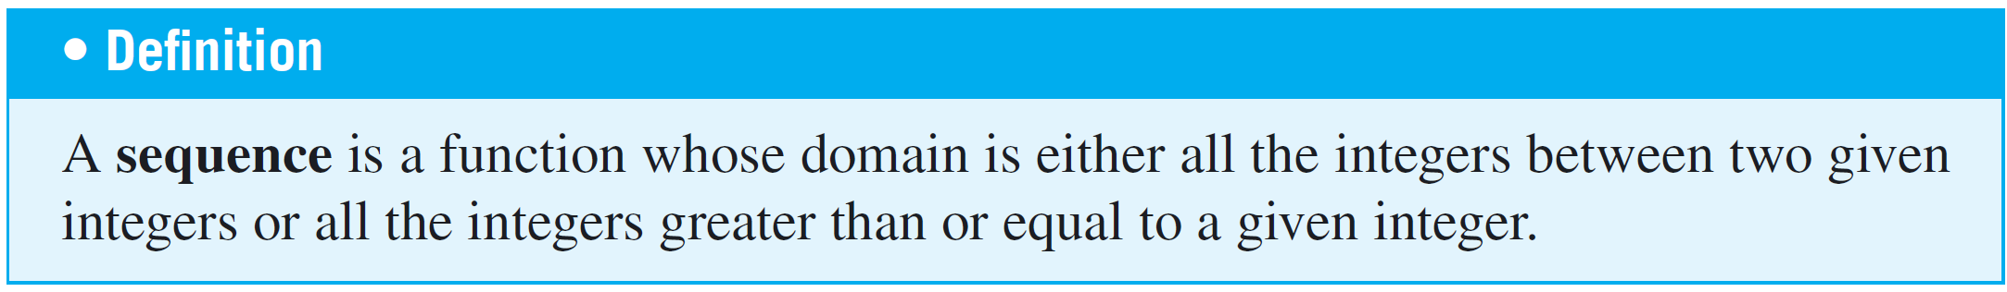
Sequence
Typically a sequence is represented as a set of elements written in a row.
An example of a sequence is,
2⁰, 2¹, 2², 2³,2⁴, …, 2^{k}
each individual element, a_{k} (read “a sub k”) is called a term.
This is generally referred as a_{k}
TMA1201 Discrete Structures & Probability, Faculty of Computing & Informatics, MMU

Slide 4
Defining a Sequence – Method 1 (Listing)
A sequence can be defined in a variety of different ways.
One informal way is to write the first few terms with the expectation that the general pattern will be obvious.
We might say, for instance, “consider the sequence 3, 5, 7, . . ..” Unfortunately, misunderstandings can occur when this approach is used.
The next term of the sequence could be 9 if we mean a sequence of odd integers, or it could be 11 if we mean the sequence of odd prime numbers.
TMA1201 Discrete Structures & Probability, Faculty of Computing & Informatics, MMU

Slide 5
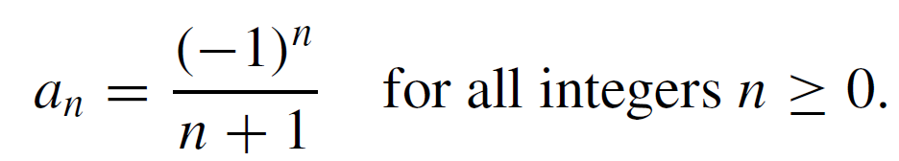
Defining a Sequence – Method 2 (Explicit Formula)
The second way to define a sequence is to give an explicit formula for its nth term.
For example, a sequence a₀, a₁, a₂ . . . can be specified by writing
The advantage of defining a sequence by such an explicit formula is that each term of the sequence is uniquely determined and can be computed in a fixed, finite number of steps, by substitution.
TMA1201 Discrete Structures & Probability, Faculty of Computing & Informatics, MMU

Slide 6
Defining a Sequence – Method 3 (Recursion)
The third way to define a sequence is to use recursion.
All recursive definition consist of two parts:
1) Initial value
2) Recurrence relation
The recurrence relation defines each later term in the sequence by reference to earlier terms and one or more initial values for the sequence.
TMA1201 Discrete Structures & Probability, Faculty of Computing & Informatics, MMU

Slide 7
Example
Given the sequence 2⁰, 2¹, 2², 2³,2⁴, … The explicit formula for the above is: a(n) =2^{n} for n ∈ N The recursive definition is: ƒ(0) = 1 ƒ(n+1) = 2 × ƒ(n) for n ∈ N
This is the initial value
This is the recurrence relation
7
TMA1201 Discrete Structures & Probability, Faculty of Computing & Informatics, MMU

Slide 8
Example: Arithmetic Sequence
The recursive definition of the arithmetic sequence is,
initial value: a₁
recurrence relation: a_{n+1} = a_{n} + d
Say a₁ = 2 and d = 4, then we will have
a₁ = 2
a₂ = a₁ + d = 2 + 4 = 6
a₃ = a₂ + d = 6 + 4 = 10
a₄ = a₃ + d = 10 + 4 = 14
a₅ = a₄ + d = 14 + 4 = 18
a₆ = a₅ + d = 18 + 4 = 22
The explicit formula for the arithmetic sequence,
a_{n} = a + ( n – 1 ) d
Say a = 2, d = 4, then we will have
a₁ = 2 + (1 - 1)4 = 2
a₂ = 2 + (2 - 1)4 = 6
a₃ = 2 + (3 - 1)4 = 10
a₄ = 2 + (4 - 1)4 = 14
a₅ = 2 + (5 - 1)4 = 18
a₆ = 2 + (6 - 1)4 = 22
8
TMA1201 Discrete Structures & Probability, Faculty of Computing & Informatics, MMU

Slide 9
Why recursion?
Recursion is one of the central ideas of computer science.
The idea is to divide and conquer:
To solve a problem recursively means to find a way to break it down into smaller sub-problems, each having the same form as the original problem, and to do this in such a way that when the process is repeated many times, the last of the sub-problems are small and easy to solve and the solutions of the sub-problems can be woven together to form a solution to the original problem.
9
TMA1201 Discrete Structures & Probability, Faculty of Computing & Informatics, MMU

Slide 10
Factorial Sequence
The Factorial is defined recursively as
initial value: f₁ = 1
recurrence relation: f_{n} = n f_{n–1}, for n≥ 2
n | f_{n}
1 | 1
2 | 2
3 | 6
4 | 24
5 | 120
6 | 720
7 | 5040
TMA1201 Discrete Structures & Probability, Faculty of Computing & Informatics, MMU

Slide 11
Fibonacci Sequence
The Fibonacci sequence is defined recursively as
initial values: f₀ = 1, f₁ = 1
recurrence relation: f_{n} = f_{n–1} + f_{n–2}, for n≥ 2
n | f_{n}
0 | 1
1 | 1
2 | 2
3 | 3
4 | 5
5 | 8
6 | 13
11
TMA1201 Discrete Structures & Probability, Faculty of Computing & Informatics, MMU

Slide 12
Proving of Explicit Formula for Recursive Sequence
Suppose you have a sequence that satisfies a certain initial value and recurrence relation
It is often helpful to know an explicit formula for the sequence, especially if you need to compute terms with very large subscripts or if you need to examine general properties of the sequence.
However, explicit formulas can be difficult to determine, and once found, needs proving for its correctness.
Proving of explicit formula can be done by using the Principles of Mathematical Induction discussed in lecture 07.
TMA1201 Discrete Structures & Probability, Faculty of Computing & Informatics, MMU

Slide 13
Example
Show that a_{n} = 1 + 2n for all n ∈ N is the explicit formula for the recursion with initial value a₀ = 1 and recurrence relation a_{n} = a_{n-1} + 2 for all n>0
Solution:
Let b_{n} = 1 + 2n
Inductive base: n = 0
b₀ = 1 + 2(0) = 1= a₀
a_{n} = b_{n} is true for n = 0
Inductive hypothesis: n = k
Assume that a_{k} = b_{k} is true for n = k
Inductive step: n = k + 1
a_{k + 1} = a_{k} + 2
a_{k + 1} = b_{k} + 2 = 1 + 2(k) + 2 (from Hypothesis)
a_{k + 1} = 1 + 2(k + 1) = b_{k+1}
Hence, by mathematical induction a_{n} = b_{n} is true for all n ∈ N
TMA1201 Discrete Structures & Probability, Faculty of Computing & Informatics, MMU

Slide 14
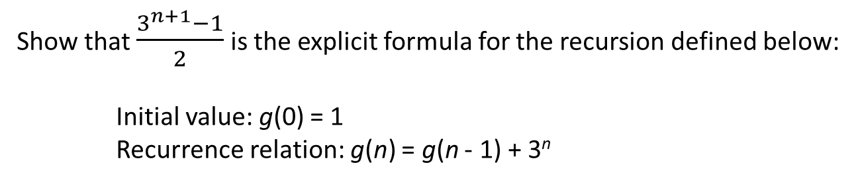
Try this
Show that $\frac{3^{n+1}−1}{2}$ is the explicit formula for the recursion defined below:
Initial value: g(0) = 1
Recurrence relation: g(n) = g(n - 1) + 3^{n}
Solution:
14
TMA1201 Discrete Structures & Probability, Faculty of Computing & Informatics, MMU

Slide 15
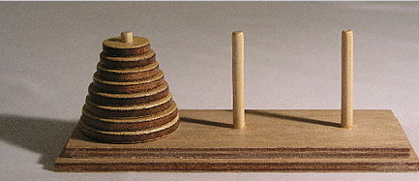
The Tower of Hanoi
The Tower of Hanoi (also called the Tower of Brahma or Lucas' Tower) is a mathematical game or puzzle. It consists of three rods and a number of disks of different sizes, which can slide onto any rod. The puzzle starts with the disks in a neat stack in ascending order of size on one rod, the smallest at the top, thus making a conical shape.
The objective of the puzzle is to move the entire stack to another rod, obeying the following rules:
1) Only one disk can be moved at a time.
2) Each move consists of taking the upper disk from one of the stacks and placing it on top of another stack or on an empty rod.
3) No larger disk may be placed on top of a smaller disk.

Slide 16
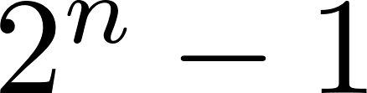
The Tower of Hanoi
The minimal number of moves required to move a stack of n disks from one rod to another is .
Can you come out with a recursive formula that compute the minimum number of moves? Verify your answer with the explicit formula for number of disks up to 5.

Slide 17
Summary
We have learnt the following concepts related to recursion:
Apart from listing the elements, a sequence can be defined by an explicit formula or by recursion(recurrence definition).
The recurrence definition involves two parts, the initial value and the recurrence relation.
A proof by induction can be applied to prove the correctness of an explicit formula for a recurrence definition.
17
TMA1201 Discrete Structures & Probability, Faculty of Computing & Informatics, MMU

Slide 18
Exercise 1
For the sequence 10, 50, 250, 1250, …
Determine the first term a and the common ratio r.
Infer an explicit formula for this sequence.
Write its recursive definition.
Proof that the explicit formula in part 2 is the correct formula for the recursive definition you have written in part 3.
Solution:
18
TMA1201 Discrete Structures & Probability, Faculty of Computing & Informatics, MMU

Slide 19

Exercise 2
Given the recursion r₀ = 1, r₁ = 7 and $r_{n}=2r_{n−1}+3r_{n−2}$, $n≥2$.
a) Find the value $r_{3}$ and $r_{4}.$
b) By mathematical induction show that $r_{n}={\left(−1\right)}^{n+1}+2∙3^{n}$for $n≥0$.

